Slide 1
Acadia DOE OBD Data Exploratory Analysis
Dingchao Zhang 11/12/2016

Slide 2
Acadia DOE Data Scope
7 System Errors, all Event Driven
8 Parameters
124 Tests from 3/25/2015 to 10/2/2015

Slide 3
Plots Types
Individual System Error Plots:
Mean, Max, Min range Plot( Mean,Max,Min on the same plot)
All System Errors Plot:
Ppk Trend Plot
Mean+-1Std Plot
Mean, Max, Min range Plot( Mean,Max,Min on the same plot)
R output graphs can be found in \\CIDCSDFS01\EBU_Data01$\NACTGx\Common\DL_Diag\Data Analysis\Storage\Knowledge base\Acadia DOE\graphs

Slide 4
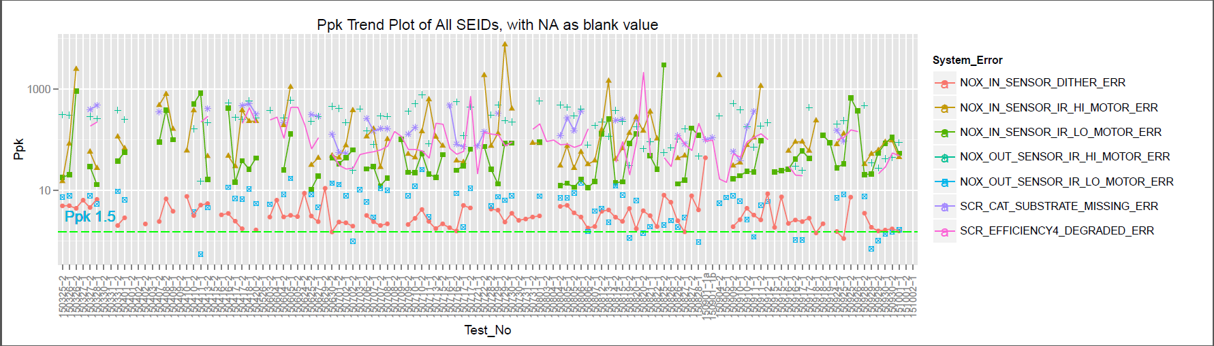
Ppk Trend All System Error Plot
Observations:
NOX_OUT_SENSOR_IR_LO_MOTOR_ERR has a few tests whose Ppk are below 1.5
NOX_IN_SENSOR_DITHER_ERR has one test whose Ppk is below 1.5
All other System Errors have Ppk above 1.5 in all tests

Slide 5
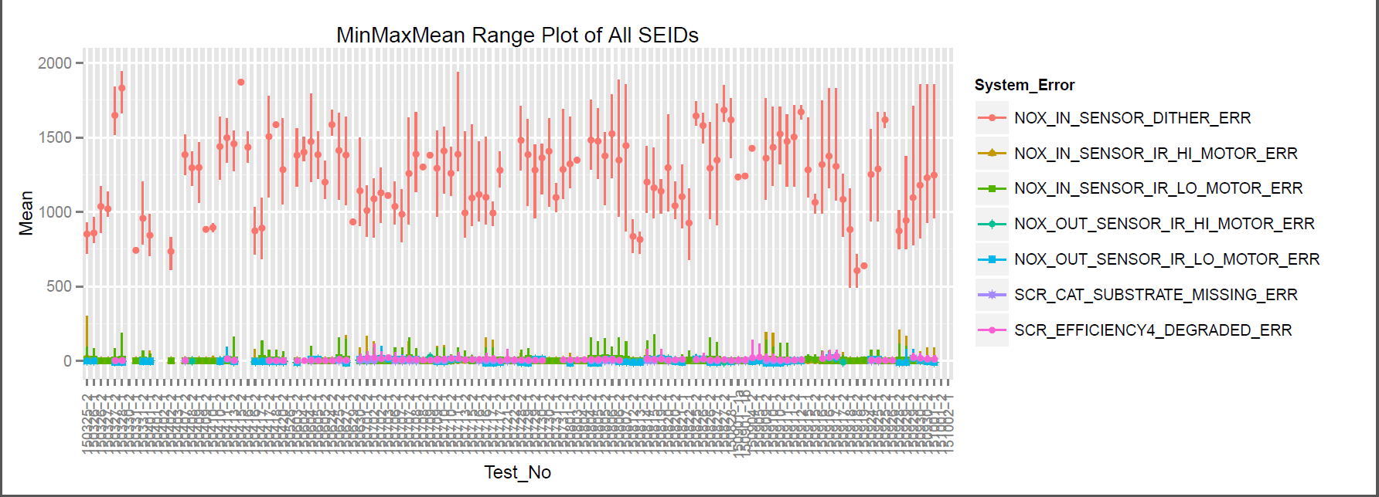
MinMaxMean Range All System Error Plot
Observations:
NOX_IN_SENSOR_DITHER_ERR has larger variance than other System Errors
NOX_IN_SENSOR_DITHER_ERR appears to have a mean below 1000 or above 1500 in the first few tests, while in the more recent tests, the mean appears between 1000 and 1500

Slide 6
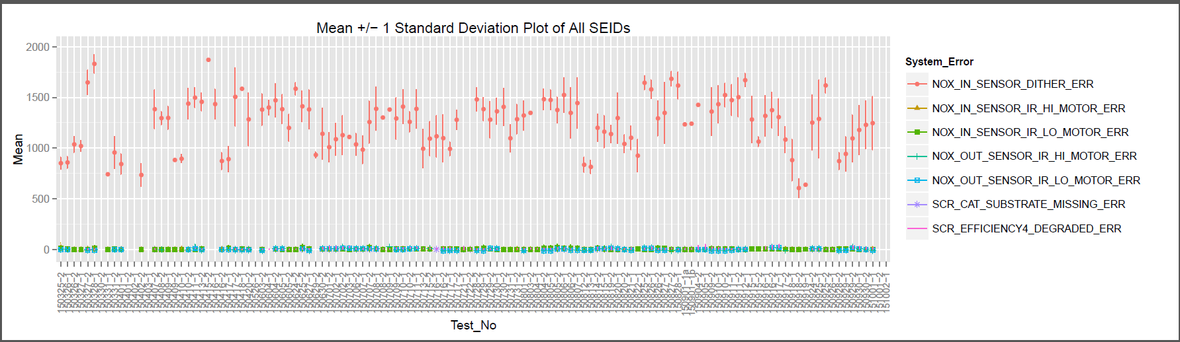
Mean+-1Std All System Error Plot
Observations:
NOX_IN_SENSOR_DITHER_ERR has the largest variance, and the variance appears gets larger as tests carry on

Slide 7
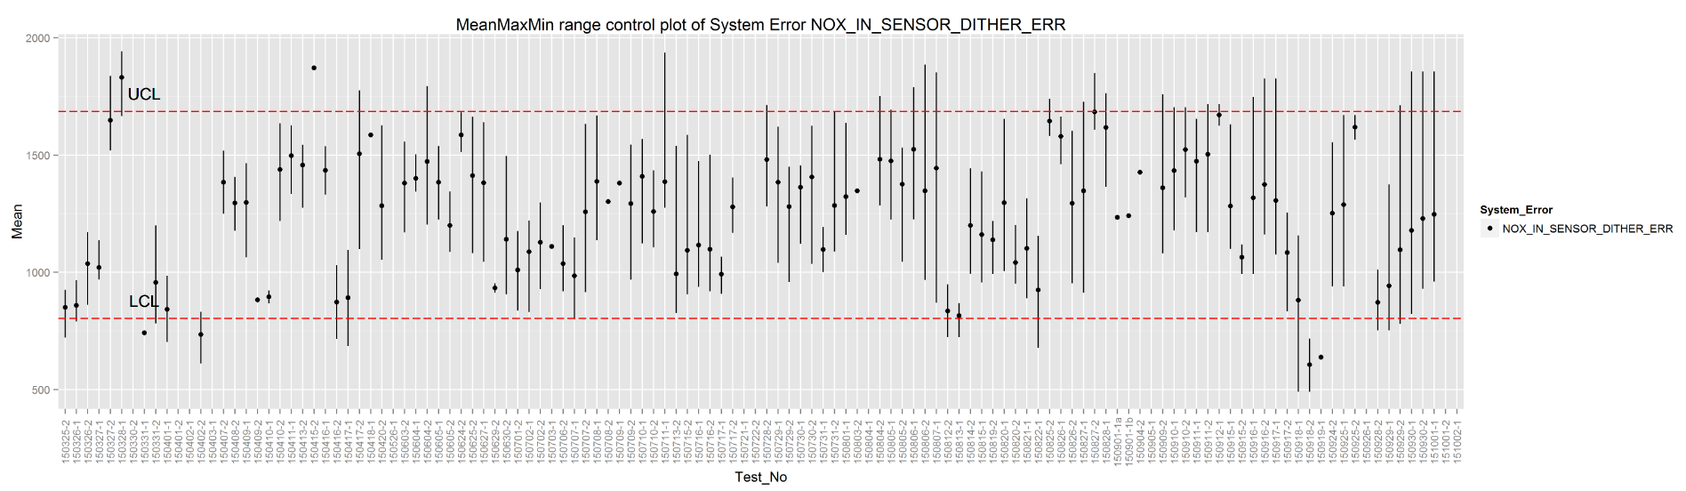
NOX_IN_SENSOR_DITHER_ERR
Observations:
NOX_IN_SENSOR_DITHER_ERR appears to have a mean below 1000 or above 1500 in the first few tests, while in the more recent tests, the mean appears between 1000 and 1500
NOX_IN_SENSOR_DITHER_ERR’s variance appears gets larger as tests carry on

Slide 8
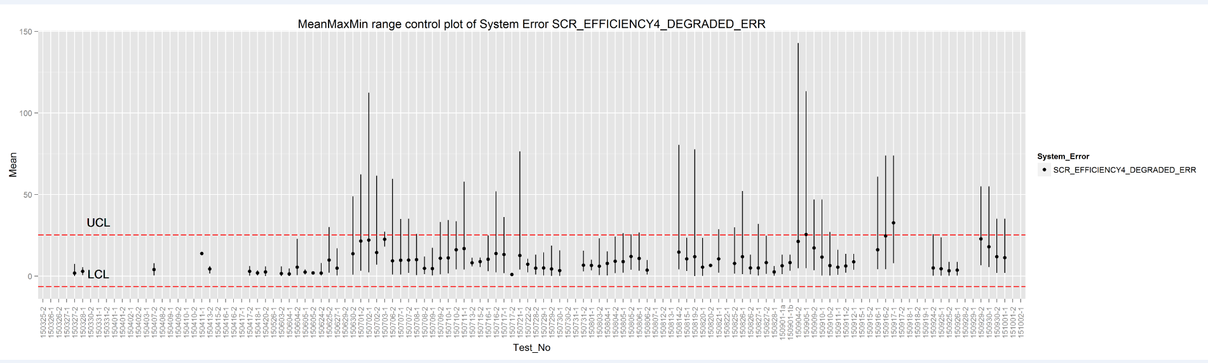
SCR_EFFICIENCY4_DEGRADED_ERR
Observations:
SCR_EFFICIENCY4_DEGRADED_ERR appears not making many decisions in the first few tests
Majority of tests show the maximum values are about 2 times larger than mean values, with a few tests showing maximum values as large as 3 times of mean values.

Slide 9
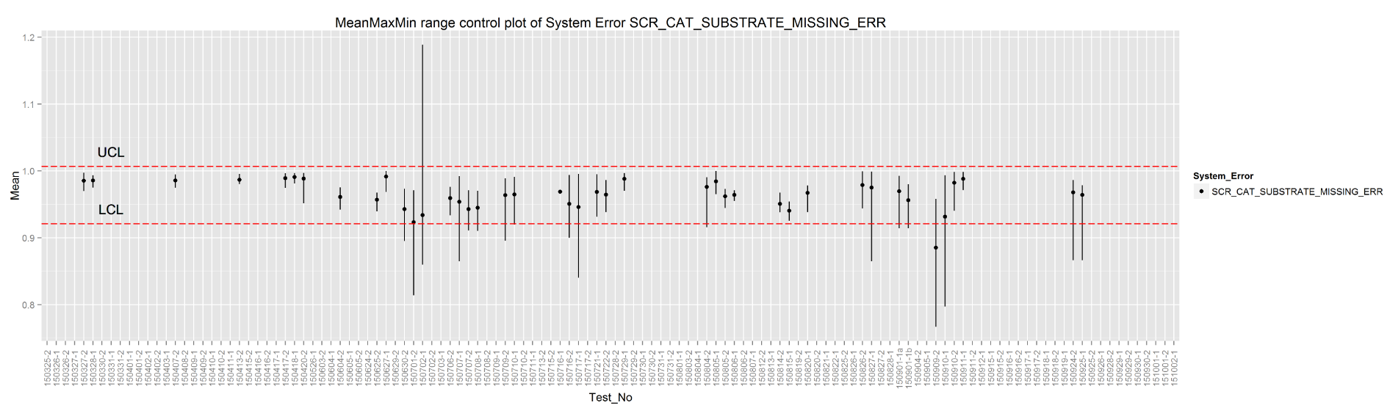
SCR_CAT_SUBSTRATE_MISSING_ERR
Observations:
SCR_CAT_SUBSTRATE_MISSING_ERR appears not making many decisions in the first few tests
SCR_CAT_SUBSTRATE_MISSING_ERR has a few tests records showing minimum or maximum value at a larger difference than mean values

Slide 10
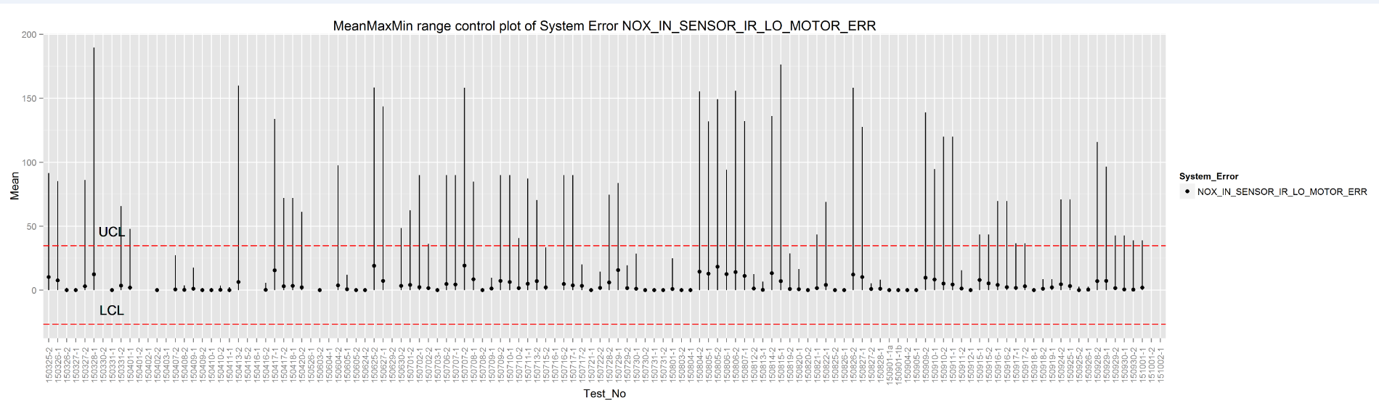
NOX_IN_SENSOR_IR_LO_MOTOR_ERR
Observations:
NOX_IN_SENSOR_IR_HI_MOTOR_ERR’s performances are correlated with NOX_IN_SENSOR_IR_LO_MOTOR_ERR’s performances

Slide 11
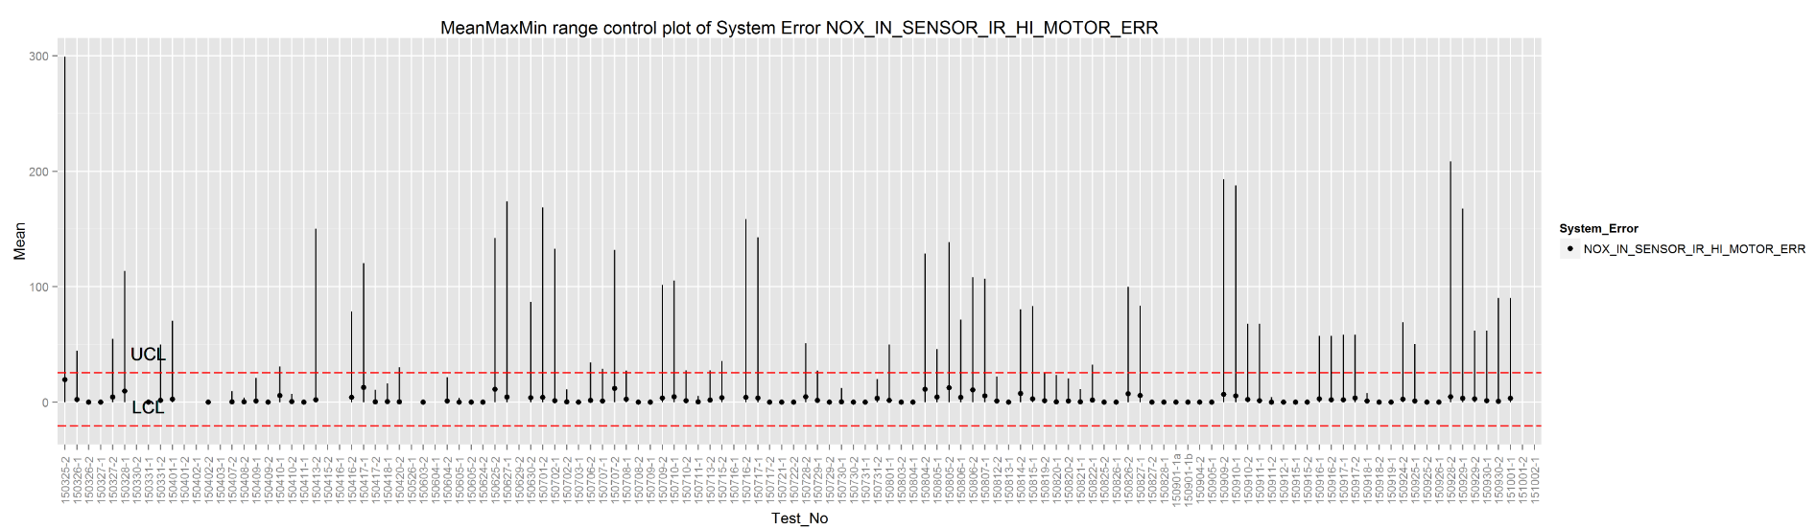
NOX_IN_SENSOR_IR_HI_MOTOR_ERR
Observations:
NOX_IN_SENSOR_IR_HI_MOTOR_ERR’s performances are correlated with NOX_IN_SENSOR_IR_LO_MOTOR_ERR’s performances
A few tests showing very large maximum values

Slide 12
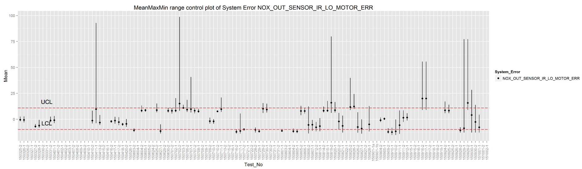
NOX_OUT_SENSOR_IR_LO_MOTOR_ERR
Observations:
NOX_OUT_SENSOR_IR_LO_MOTOR_ERR’s performances are highly correlated with NOX_OUT_SENSOR_IR_HI_MOTOR_ERR’s performances
A few tests showing very large maximum values

Slide 13

NOX_OUT_SENSOR_IR_HI_MOTOR_ERR
Observations:
NOX_OUT_SENSOR_IR_LO_MOTOR_ERR’s performances are highly correlated with NOX_OUT_SENSOR_IR_HI_MOTOR_ERR’s performances
A few tests showing very large maximum values

Slide 14
Unsupervised Machine Learning Practices
To provide insight into the 1st goal of the Acadia DOE tests listed by Paul
Tools:
Python scikit, pandas, numpy, matplot packages are used to complete the following analysis.
Scripts are not attached.

Slide 15
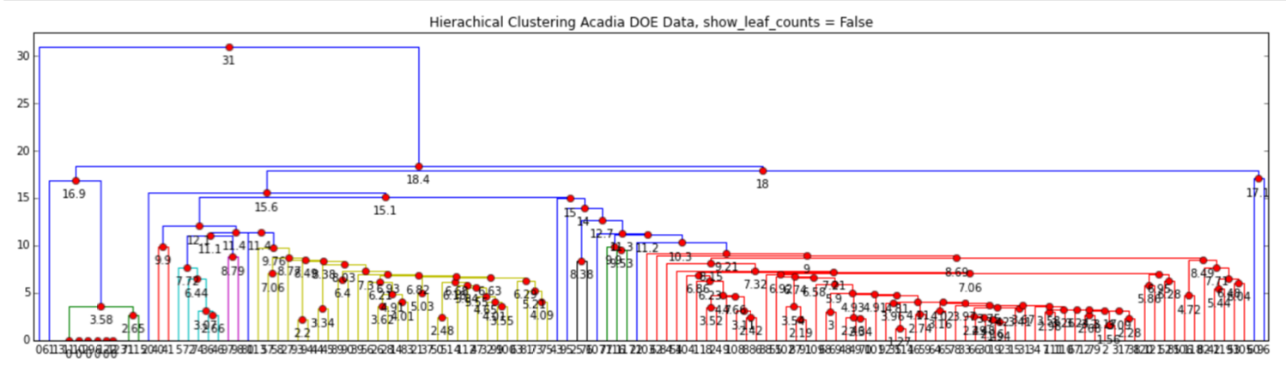
Hierarchical Clustering
Bottom-Up (agglomerative): Starting with each item in its own cluster, find the best pair to merge into a new cluster. Repeat until all clusters are fused together. We begin with a distance matrix which contains the distances between every pair of objects in our database.
Dendrogram of Acadia DOE Tests using OBD Data

Slide 16
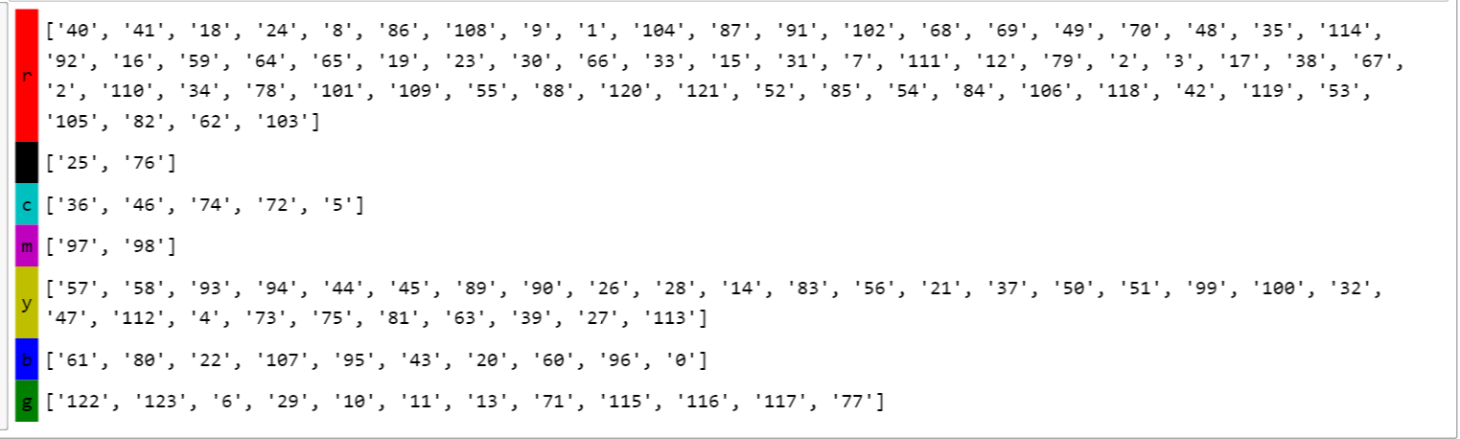
Hierarchical Clustering Groups
Refers to the color in the dendrogram in slide 15

Slide 17
Principle Component Analysis
Principal component analysis (PCA) is a statistical procedure that uses an orthogonal transformation to convert a set of observations of possibly correlated variables into a set of values of linearly uncorrelated variables called principal components.
The major goal of principal components analysis is to reveal hidden structure in a data set. In so doing, we may be able to
• identify how different variables work together to create the dynamics of the system
• reduce the dimensionality of the data
• decrease redundancy in the data
• filter some of the noise in the data
The principal components are orthogonal because they are the eigenvectors of the covariance matrix.

Slide 18
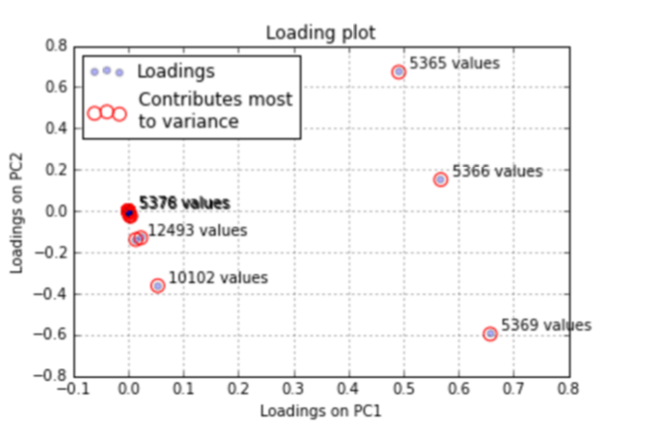
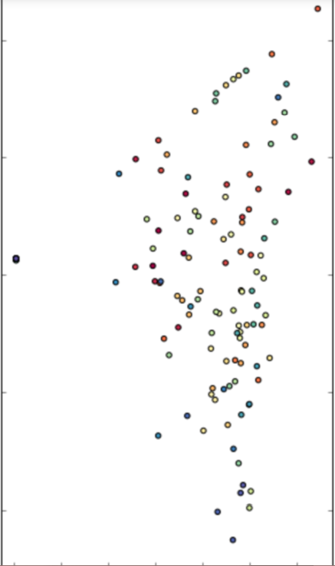
PCA Factors Loading Analysis and Scatter Plot of 1st, 2nd Components of PCA
Factors Loading Score Plot
PCA Scatter Plot
X axis : 1st component of Eigenvector
Y axis: 2nd component of Eigenvector

Slide 19
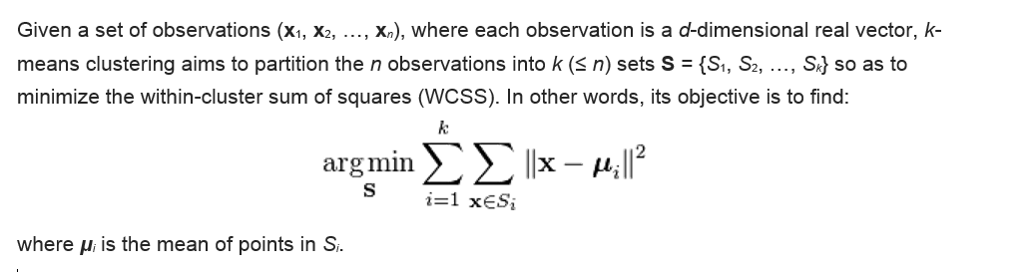
K Means Clustering

Slide 20
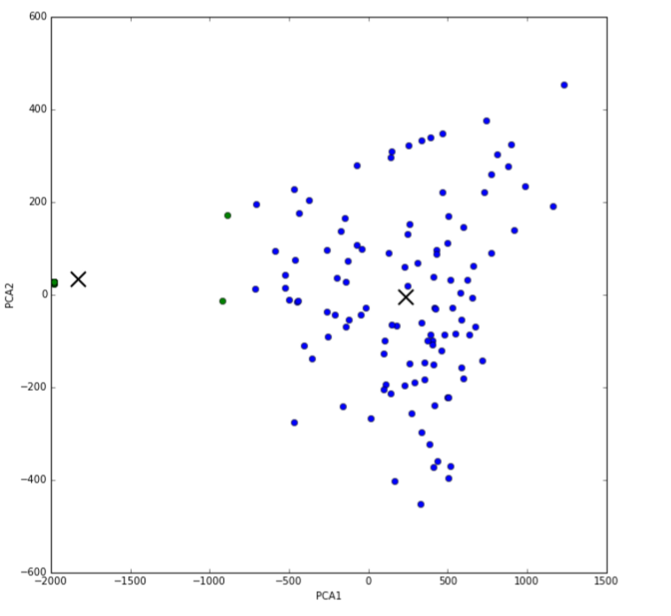
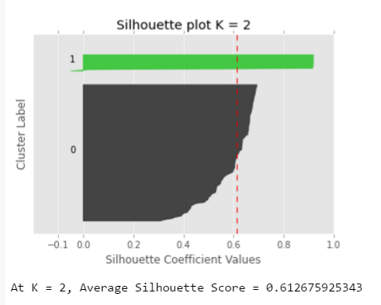
K Means Clustering, K = 2

Slide 21
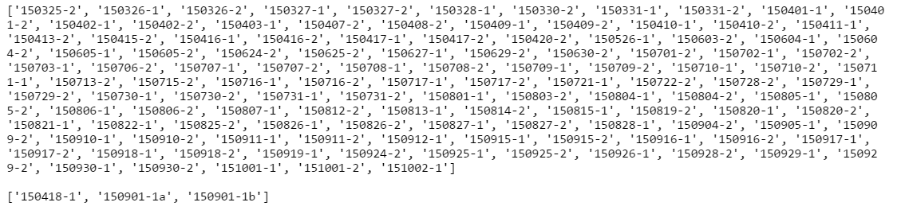
K Means Clustering Subgroups, K = 2

Slide 22
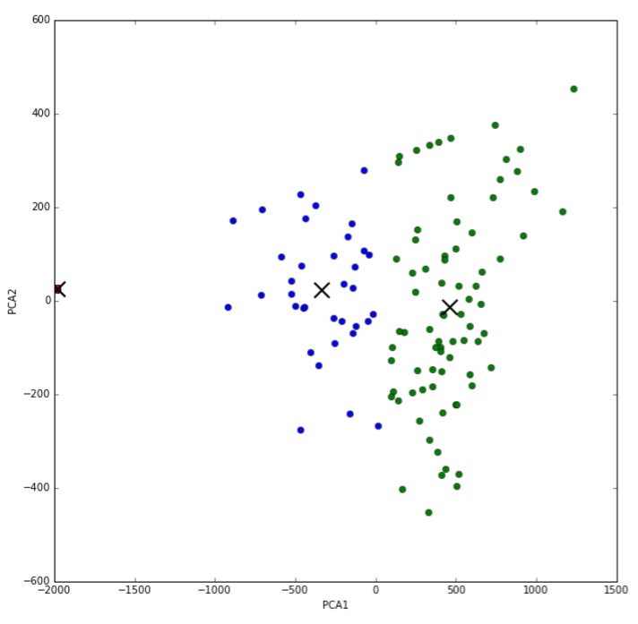
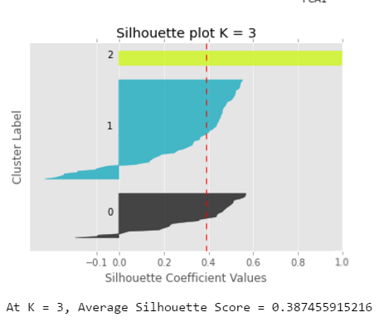
K Means Clustering Subgroups, K = 3

Slide 23
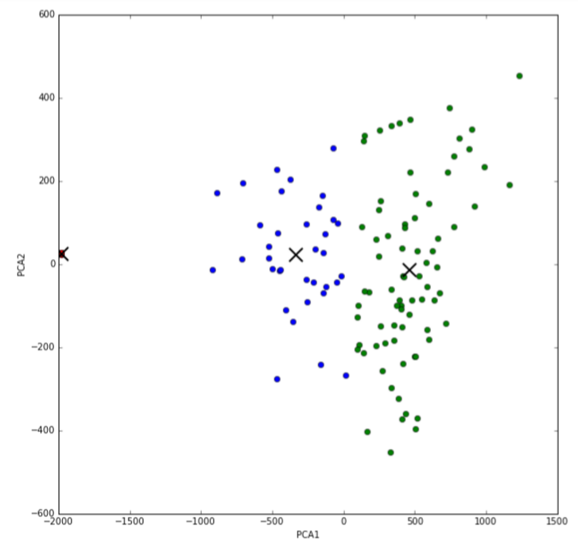
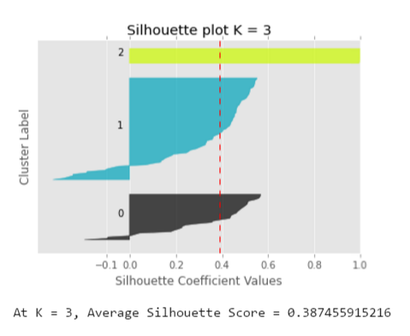
K Means Clustering, K = 3

Slide 24
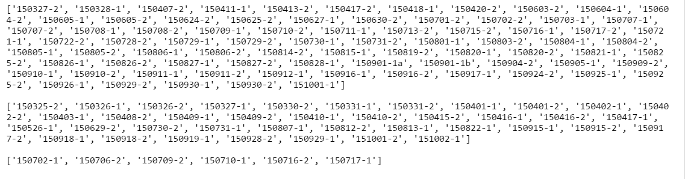
K Means Clustering Subgroups, K = 3

Slide 25
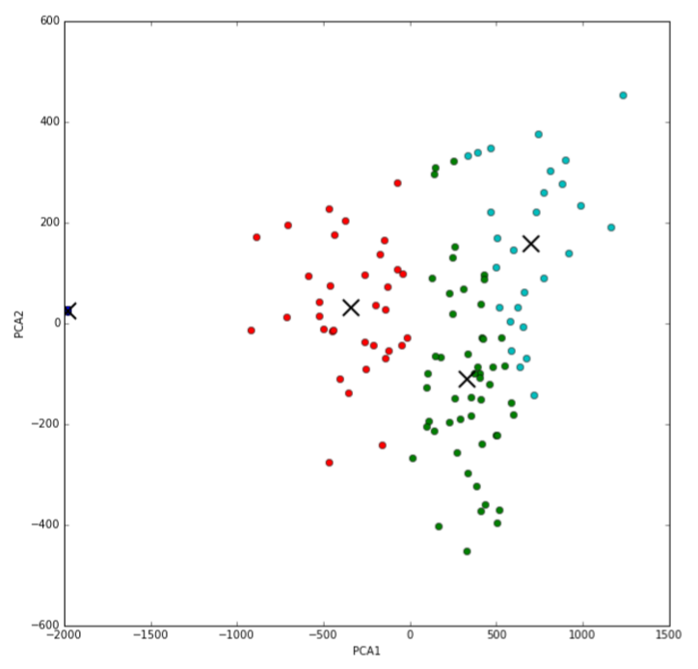
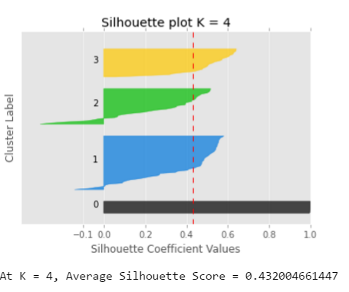
K Means Clustering, K = 4

Slide 26
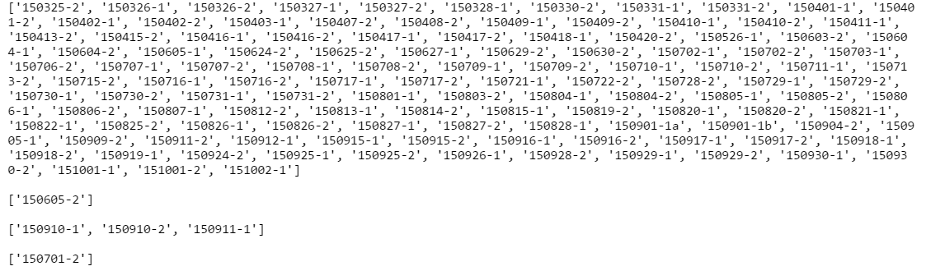
K Means Clustering Subgroups, K = 4

Slide 27
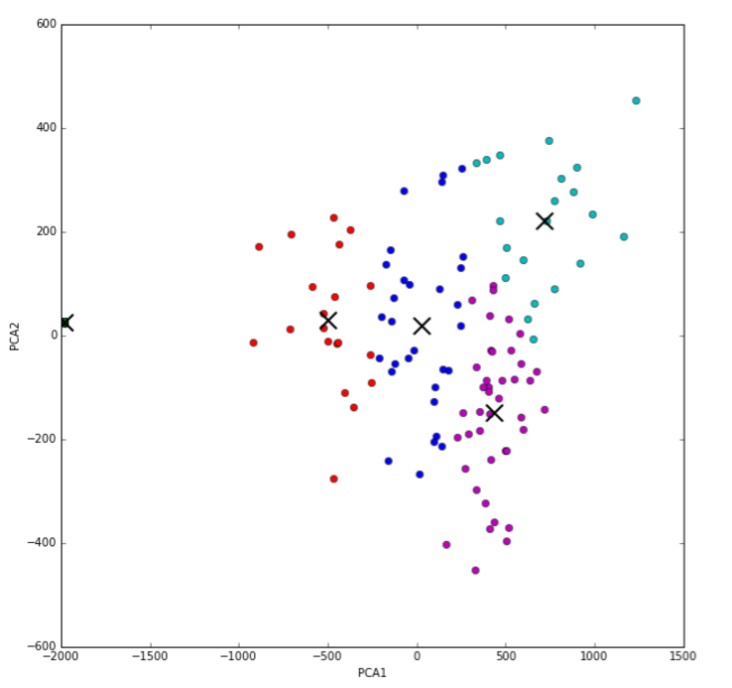
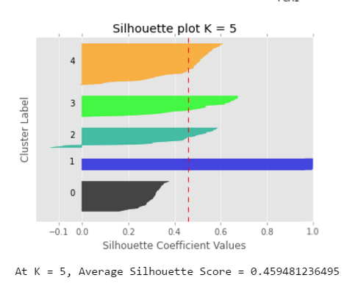
K Means Clustering, K = 5

Slide 28
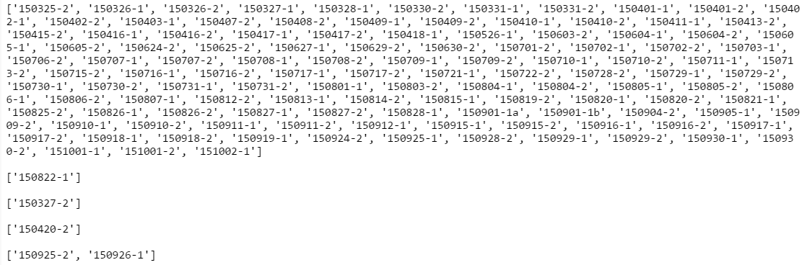
K Means Clustering Subgroups, K = 5

